Slide 1
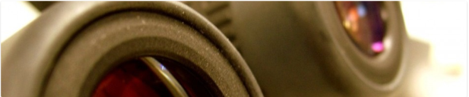

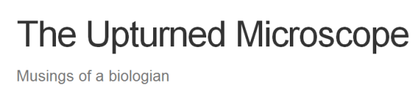
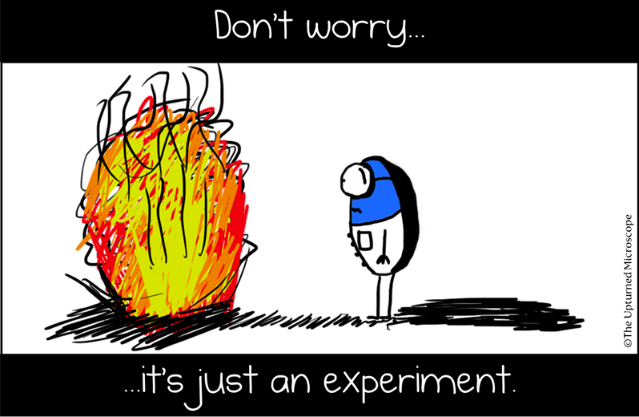
FROM BENCH TO KEYBOARD
Nik Papageorgiou
(& how I learned to stop worrying and leave the lab)

Slide 2
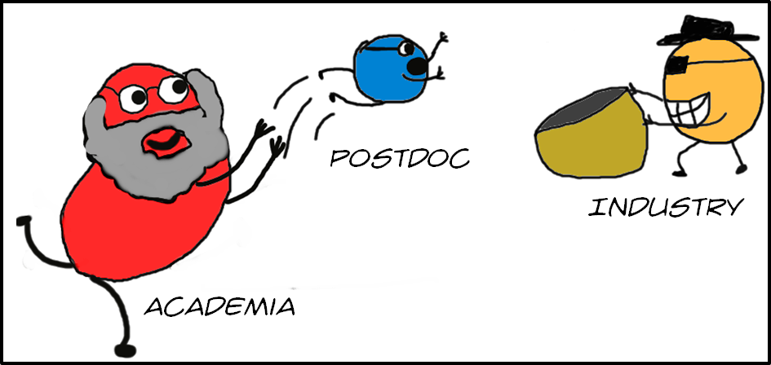
My story

Slide 3
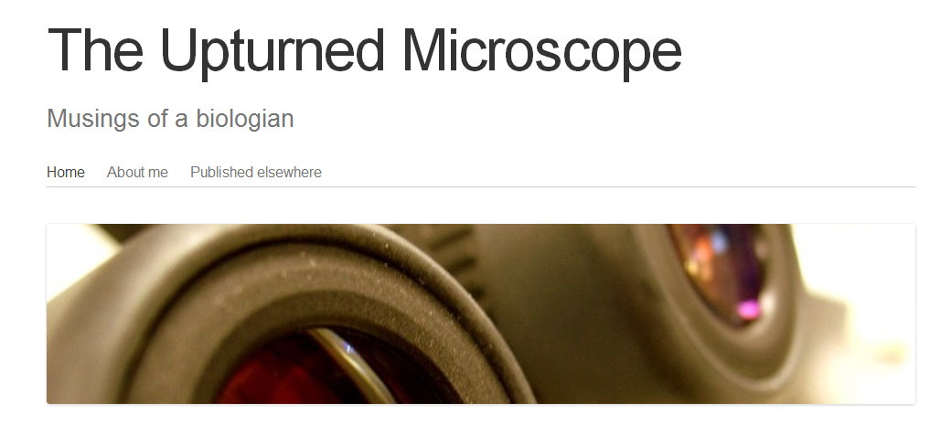
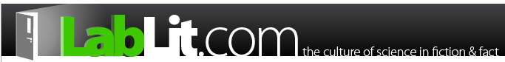
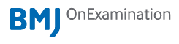

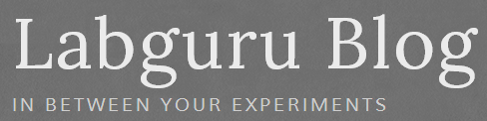

Ooooh! Logos!

Slide 4
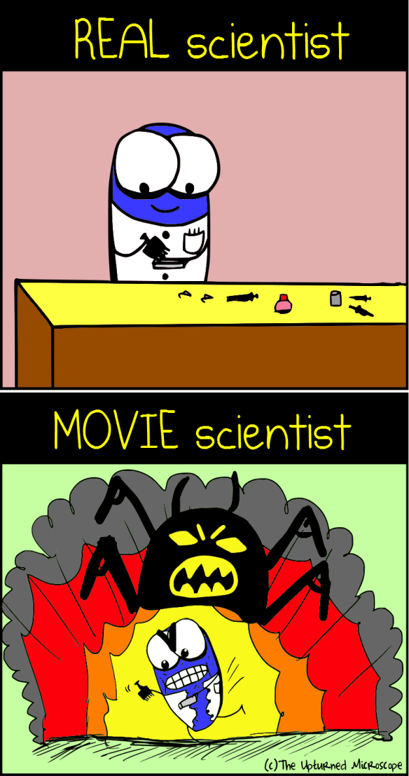

Science Communication
Informing the public of science-related topics (experts to non-experts)
De-mystifying the scientific process

Slide 5
Examples
Publishing
Journalism
Media
Blogging
Comics?
Natureblogs
NewScientist
Wired magazine
Guardian Science
Scienceblogs

Slide 6
Advantages
Make science more understood and appreciated
Generate support for scientific endeavours
Influence governmental decisions
Inform/educate the individual (coping in a sci/tech society)

Slide 7
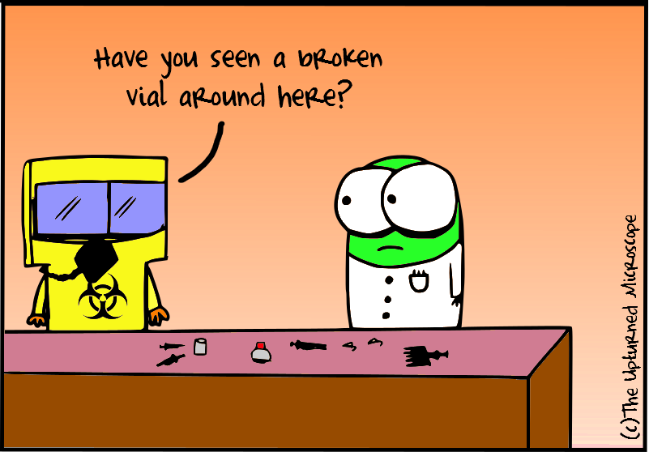
Risks
Miscommunication
Dumbing down
Alienation
Scientism
“What’s the point?”

Slide 8
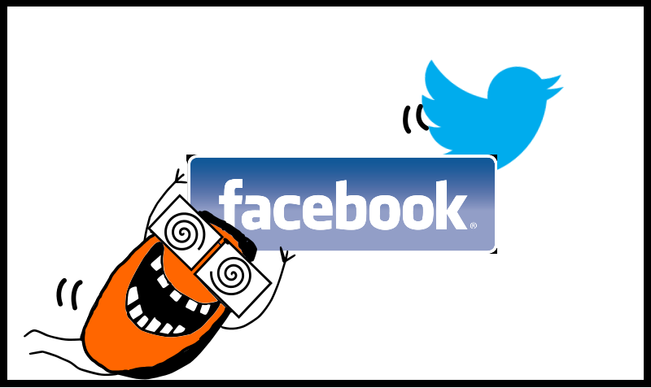
Social media
The Good:
Open/Free
Regular
Up-to-date
“Live”
Networking
Quick
Variety
The Bad:
Impact-focused
Biased
Inaccurate
“Too much”

Slide 9
Online presence
Engaged network > crowds of apathy
Innovative + informative
Social media: Tailored + Measured

Slide 10

What I have learned
Science communication is not easy
Stick to what you know
Find your niche topic, format and audience
Worry about the feedback, not the numbers
Network with others
Humour is a great tool
Keep at it!
Communicate science like a SIR!

Slide 11
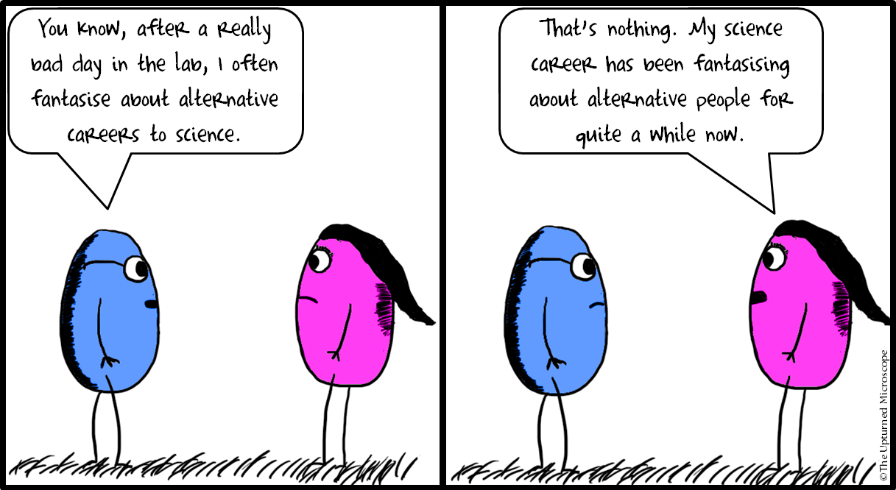

Thank you for your attention!
Questions?
www.upmic.wordpress.com

